Slide 1
Seismicity and Ice Loading
Clara and Kate
Notes:
Clara

Slide 2
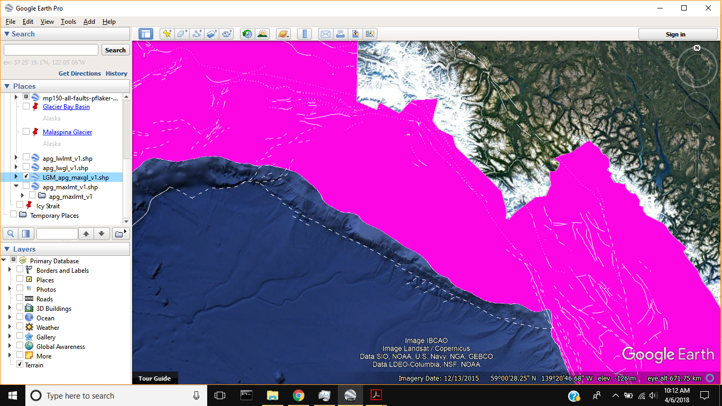
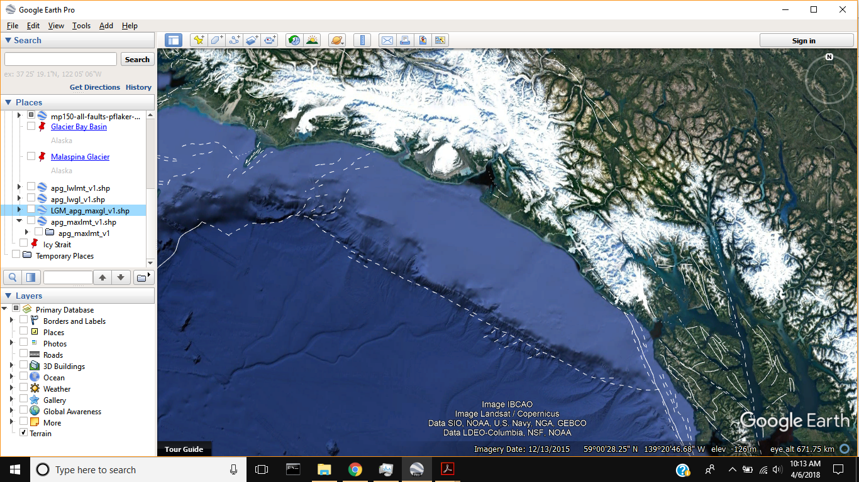
Background
The Region
LGM thickness = 1 km
Malaspina thickness = 600m
LGM Ice
Current Ice
Bering Malaspina
Icy
Bay
Notes:
Kate

Slide 3
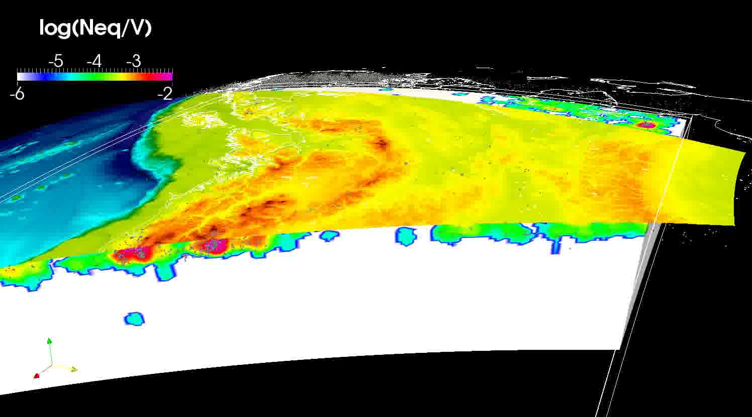
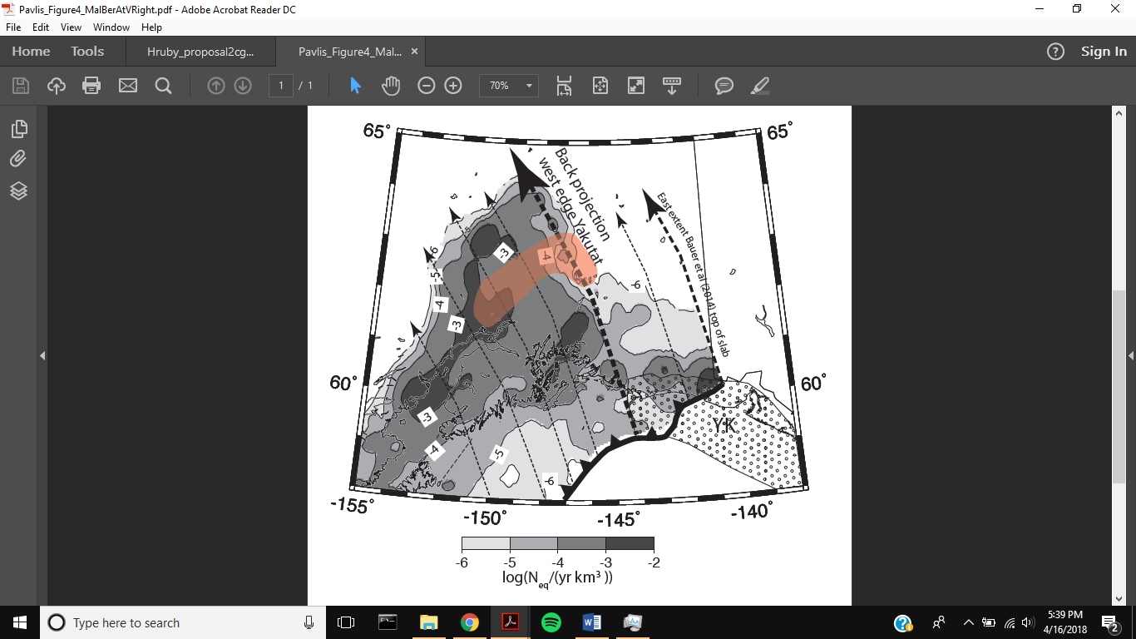
Pavlis et al.
Animation 1 >
^ Figure 4
Alaska Earthquake Center Data from 1990 to 2015
447,288 earthquakes with 64,971 events larger than magnitude 2.5
From 1973 – 2000 there was a 47m thinning in Malaspina (Mustkett, 2003) and in the early 2000’s there is a thinning of about 5 m/a (Sauber, 2005)
Notes:
Clara

Slide 4
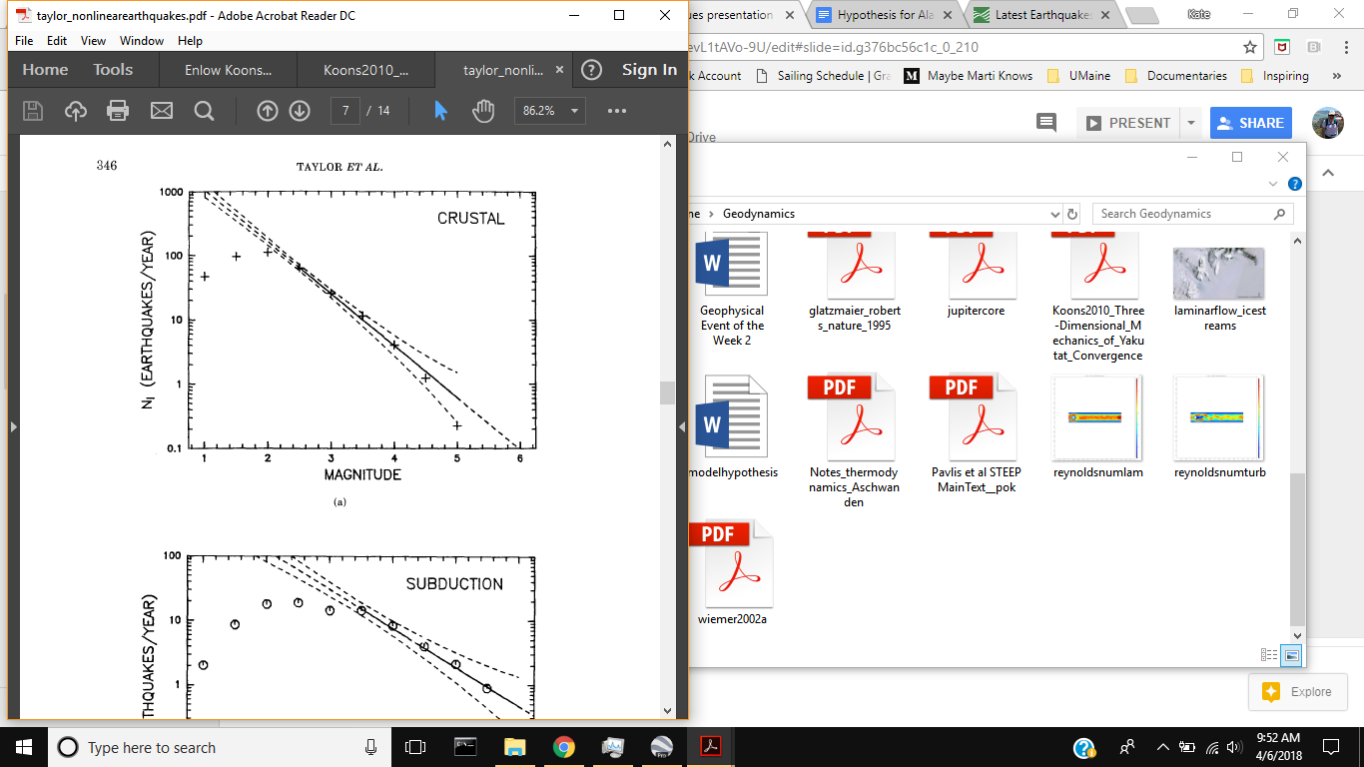
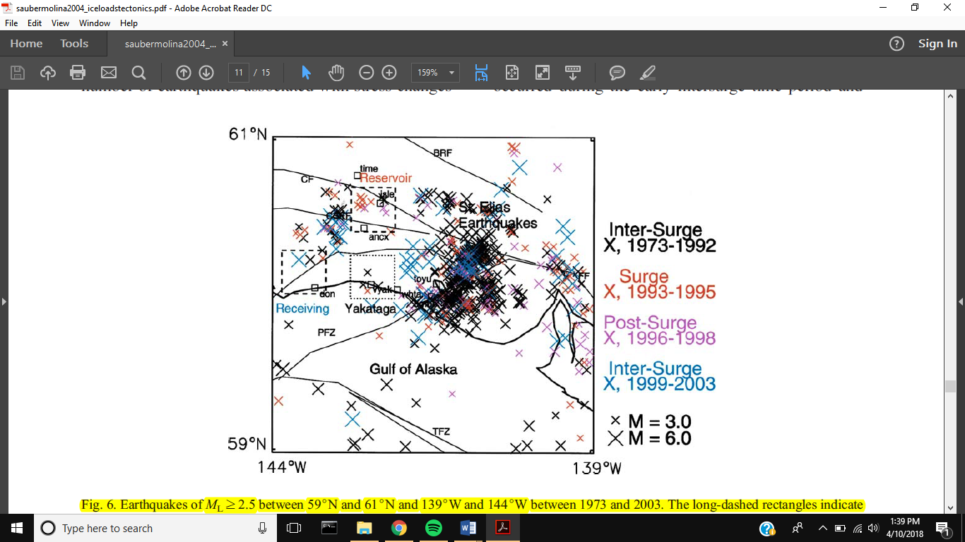
Background
Seismicity
Hokkaido Corner, Japan (Taylor, et. al, 1990)
Bagley Ice Valley Surge, 1973-2003
With a decrease in ice of 50 m, 82% of the earthquakes in the region happened during the surge and there was an 1 order of magnitude increase in size (Sauber, 2004).
Notes:
Kate

Slide 5
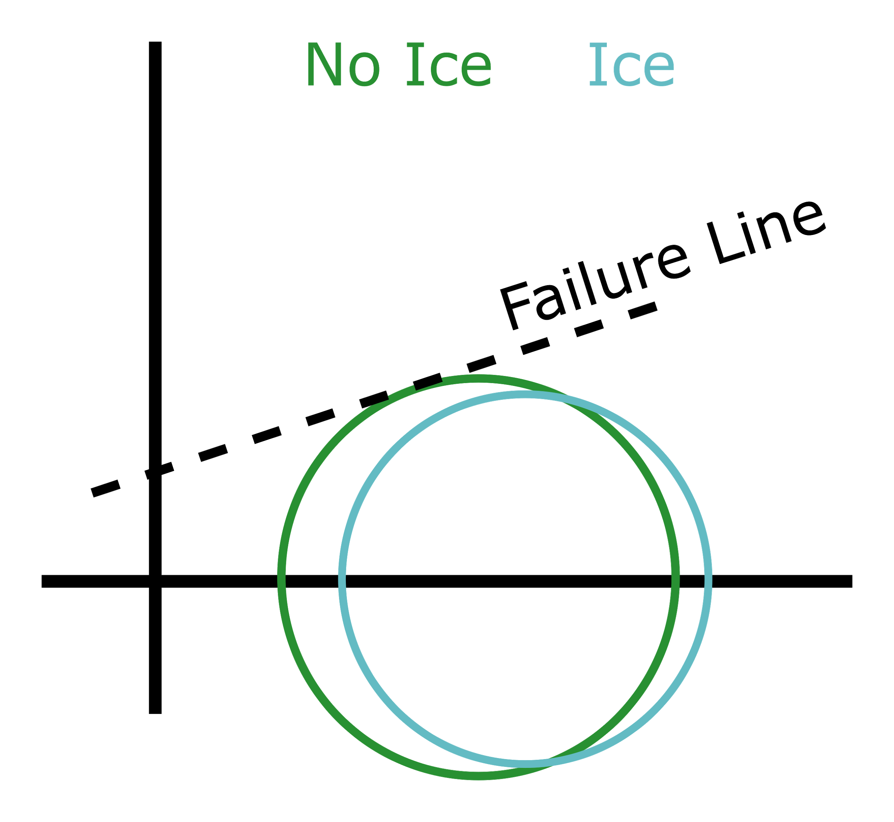
Mohr’s Circle
𝞼₃ 𝞼₃ 𝞼₁ 𝞼₁
Notes:
Clara

Slide 6
Hypothesis
With the unloading of glacial ice, the frequency and magnitude relationship of low-magnitude earthquakes in the Yakutat region will change, causing a maximum frequency between magnitudes of 1.4 and 2.4.
Notes:
Kate

Slide 7
Results
Part 1
Strain rate increases after ice is lost
Hypothesis
With the unloading of glacial ice, the frequency and magnitude relationship of low-magnitude earthquakes in the Yakutat region will change, causing a maximum frequency between magnitudes of 1.4 and 2.4.
Notes:
Clara …. Through to gif

Slide 8
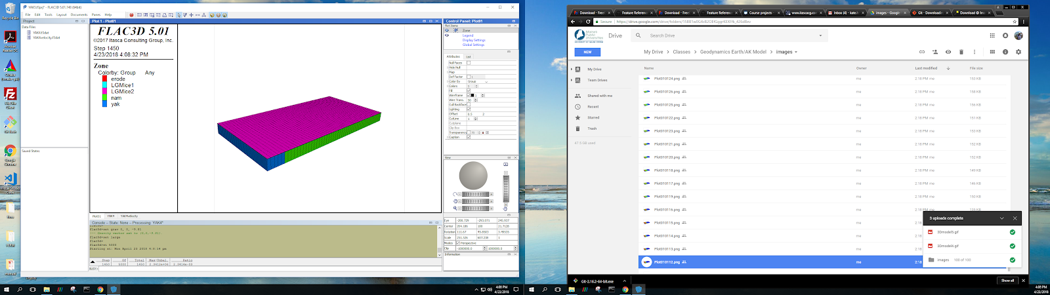
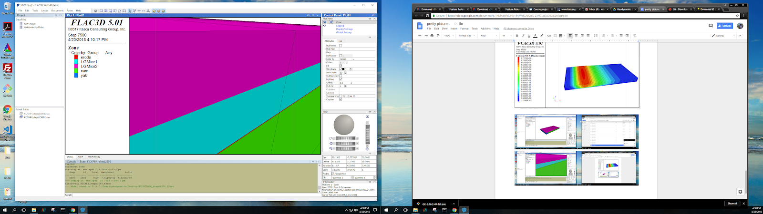
Our Model
Geometry

Slide 9
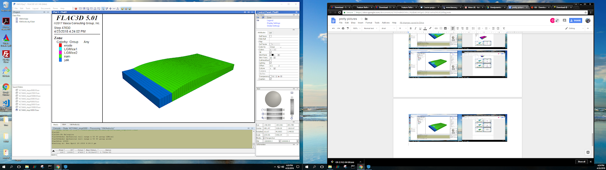
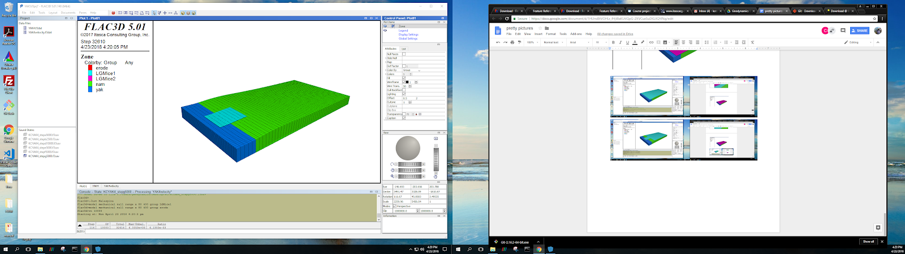
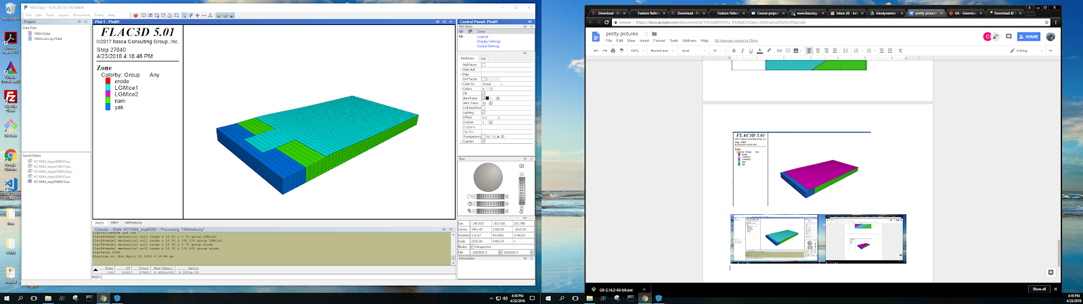
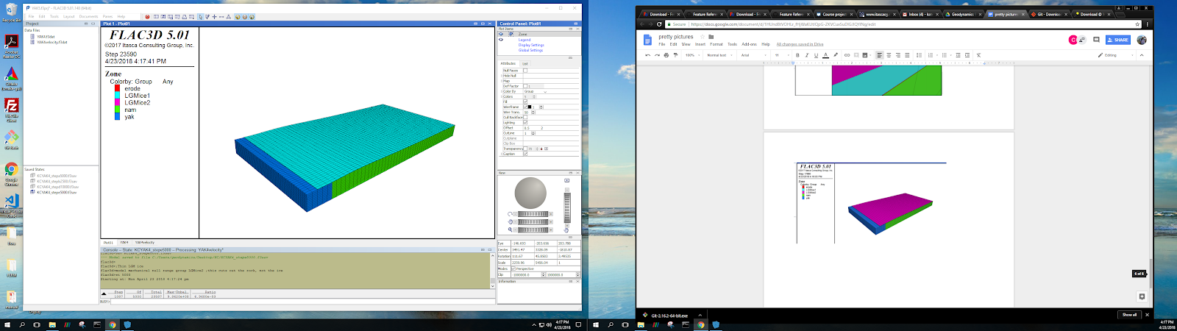
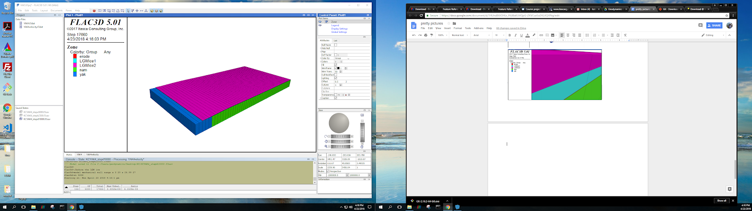
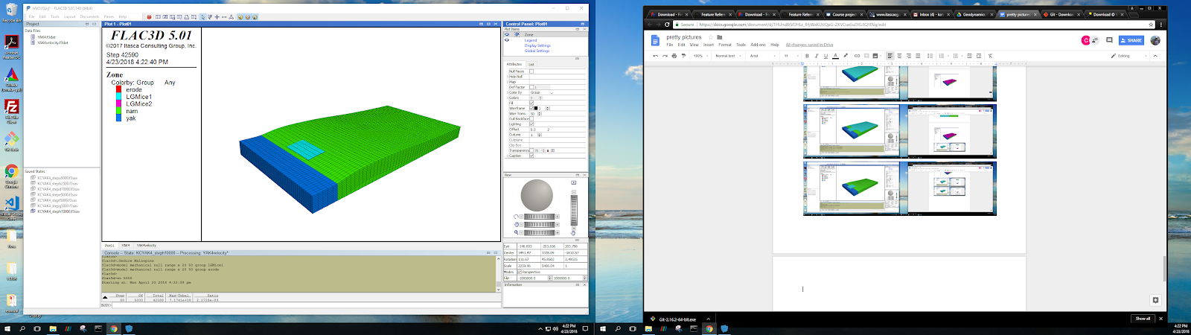
Our Model
Geometry

Slide 10
Our Model
Parameters Velocity for the Yakutat: 1.59 x 10^-4
Lithosphere
Density 2700 kg/m³
Bulk modulus 1 x 10¹⁰
Shear modulus 3 x 10⁹
Friction angle 35º
Cohesion 1 x 10⁸
Underlying weak layer
Friction angle 5º
Ice
Density 917 kg/m³
Bulk modulus 2 x 10⁹
Shear modulus 3.8 x 10⁹

Slide 11
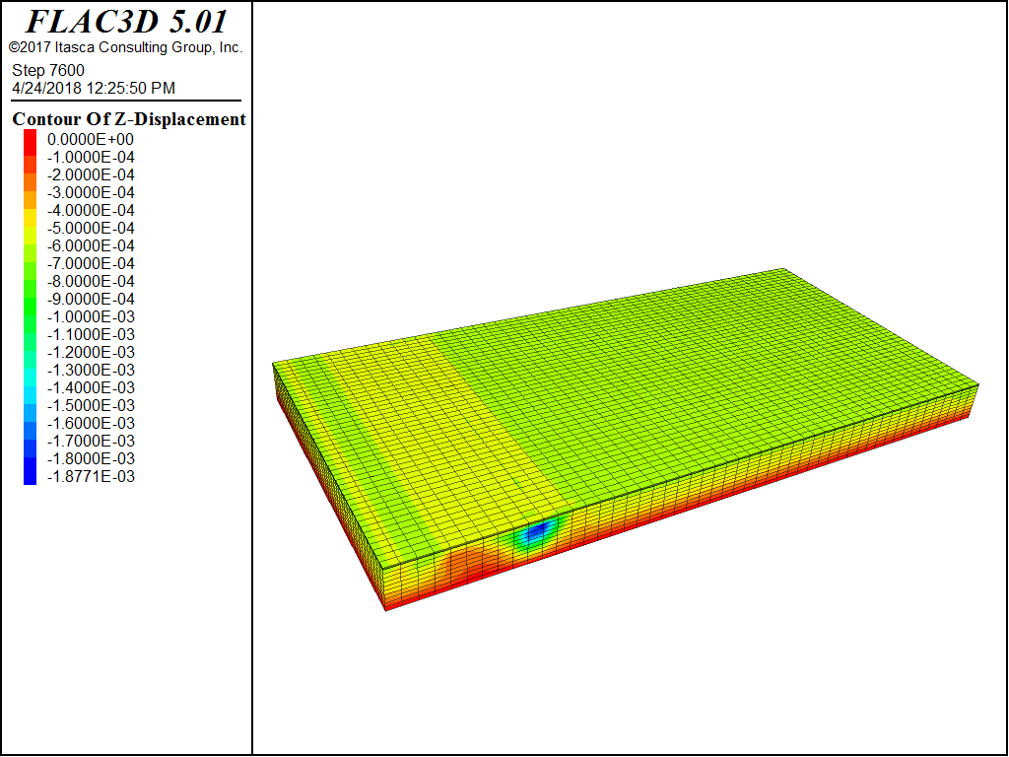
Model Results
Model
Results
Z - displacement
Notes:
Both

Slide 12
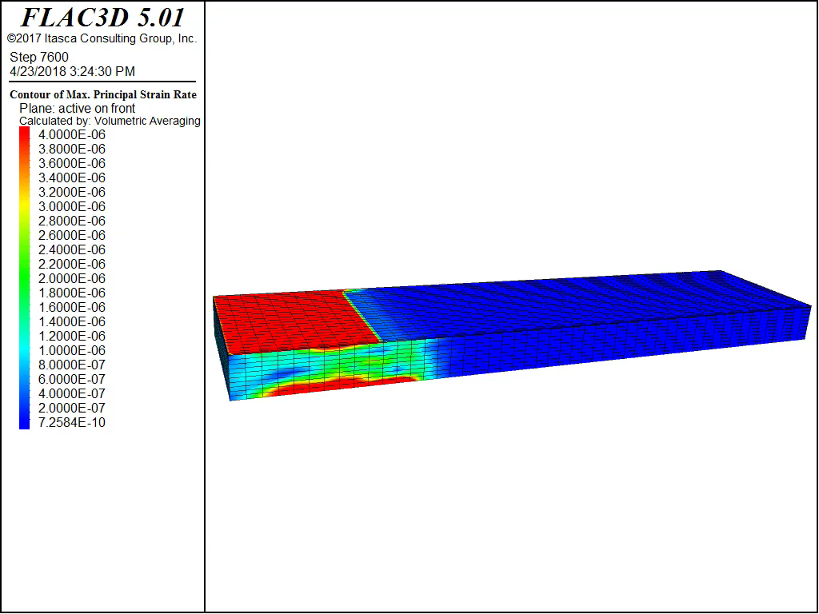
Model Results
Model
Results
Maximum Principal
Strain Rate
Notes:
Both

Slide 13
Results
Part 2
The frequency-magnitude plots in this region have a maximum around 1.4
The plots have a distinct curve
Hypothesis
With the unloading of glacial ice, the frequency and magnitude relationship of low-magnitude earthquakes in the Yakutat region will change, causing a maximum frequency between magnitudes of 1.4 and 2.4.
Notes:
Clara …. Through to gif

Slide 14
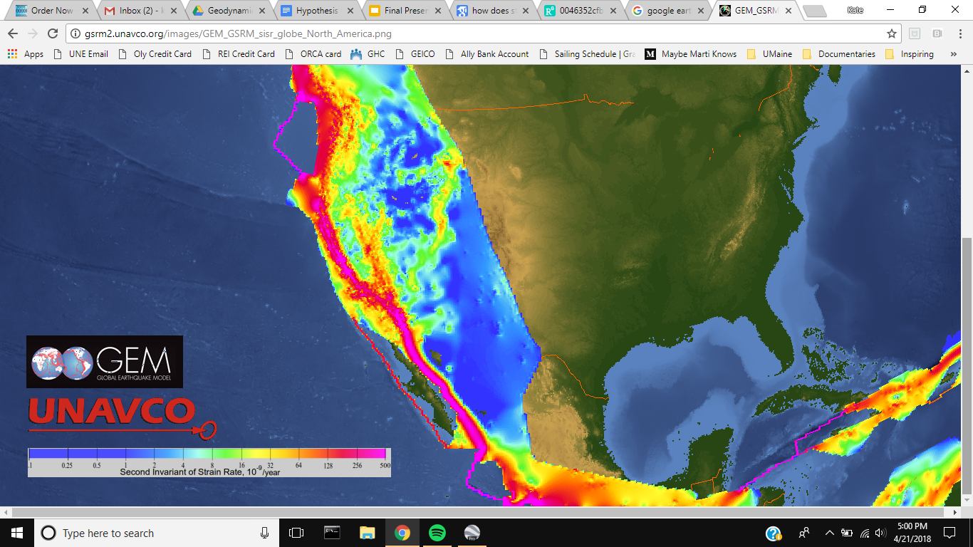
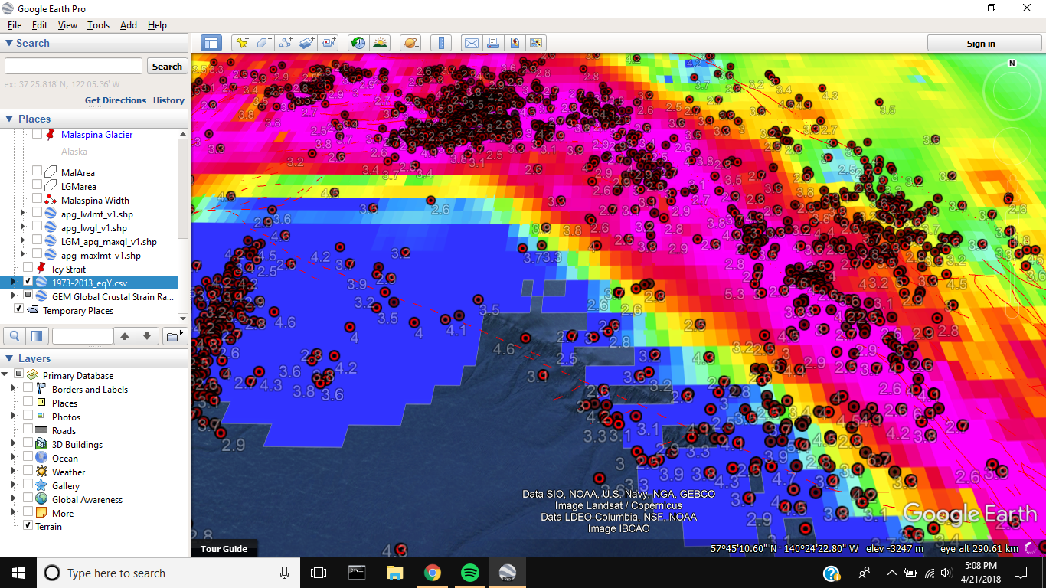
Strain Rates and Earthquakes 2013-2018
Earthquake Data from USGS
Notes:
Malaspina, Bering, and St. Elias region for just 2013-2018

Slide 15
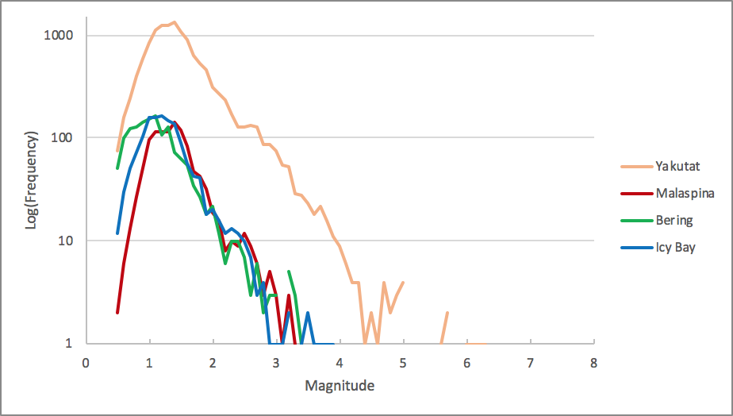
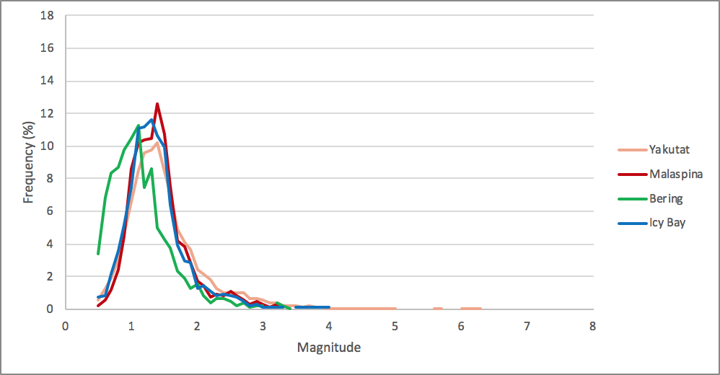
Recent Frequency Magnitude Plots 2013-2018 Earthquake Data from USGS >
Notes:
Malaspina, Bering, and St. Elias region for just 2013-2018

Slide 16
Discussion
Ice load reduction causes earthquakes
Ice is lost and there is an increase in strain rate (higher strain rate = more earthquakes)
Depending on time and the amount of ice taken away, that strain rate dissipates or is lost quickly in a large earthquake
The frequency-magnitude plots in the Yakutat region have a maximum around 1.4 and a distinctive curve
Our hypothesis is correct

Slide 17
Sources
Enlow, R and Koons, P. 1998. Critical wedges in three dimensions: analytical expressions from Mohr-Coulomb constrained perturbation analysis. Journal of Geophysical Research; 103 (B3): 4897-4914
Koons, P., Hooks, B., Pavlis, T., Upton, P. and Barker, A. 2010. Three-dimensional mechanics of Yakutat convergence in the southern Alaska plate corner. Tectonics; 29: 1-17
Muskett, et al. 2003. Multi-decadal elevation changes on Bagley Ice Valley and Malaspina Glacier, Alaska. Geophysical Research Letters: 30 (16): 1-4
Pavlis, et al. Lithospheric scale structure of Alaska: a unified three-dimensional model from results of STEEP (St. Elias Erosion/tectonics Project).
Sauber, J. and Molnia, B. 2003. Glacier ice mass fluctuations and fault instability in tectonically active Southern Alaska. Global and Planetary Change; 42: 279-293
Sauber, et al. 2005. Ice elevations and surface change on the Malaspina Glacier, Alaska. Geophysical Research Letters; 32: 1-4
Taylor, D., Snoke, J., Sacks, I. and Takanami, T. 1990. Nonlinear frequency-magnitude relationships for the Hokkaido Corner, Japan. Seismological Society of America; 80 (2): 340-35
Questions?

Slide 18
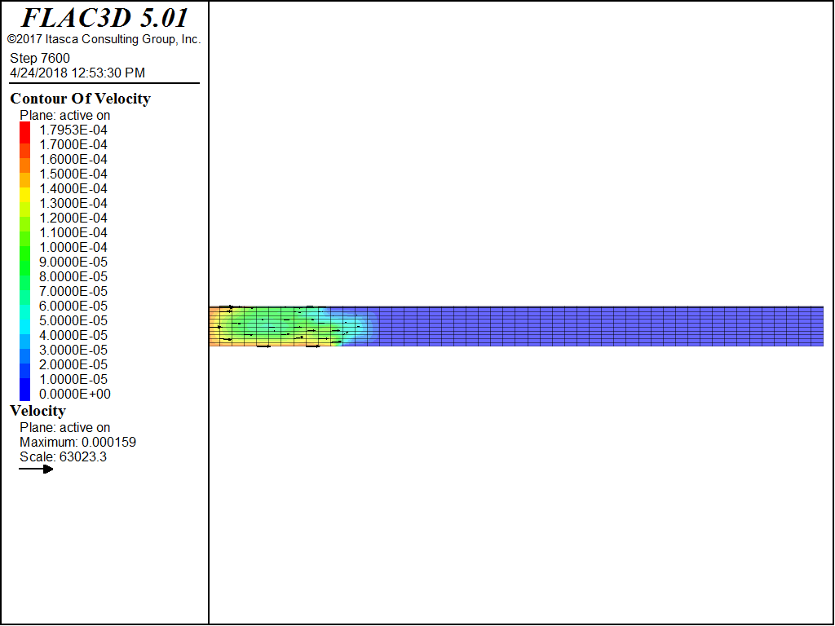
Model Results
Model
Results
Velocity
Notes:
Both

